Slide 1
Linux Kernel & Porting Linux

Slide 2
Linux Kernel and Porting Linux
Agenda
Linux Kernel
Working environment (work station)
Bootloader
Building a toolchain
Building a Linux Kernel
Porting Linux

Slide 3
Training objectives
After this lecture you’ll able to:
Know more about linux bootloader
Know more about linux kernel
Know more about linux file system
Basic steps to build linux system

Slide 4
Type of Host (workstation)
Setup working environment
Unix workstation
Linux workstation
Window workstation

Slide 5
Development Setups
There are 3 types of development environ-ment settings:
Linked Setup
Removable Storage Setup
Standalone Setup

Slide 6

Linked Setup
The target and the host are permanently linked together using a physical cable
No physical hardware storage device is being transferred between the target and the host

Slide 7
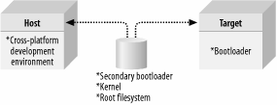
Removable Storage Setup
Using removable storage instead of physical cable
a storage device is written by the host, is then transferred into the target, and is used to boot the device.

Slide 8

Standalone Setup
the target is a self-contained development system and includes all the required software to boot,operate, and develop additional software

Slide 9
What we need?
Cross-Platform development toolchain
Bootloader
Usually provided by the vendor
Linux kernel
Linux kernel + some patches if needed
Filesystem
Busybox
Device node
Configuration

Slide 10
Tool chain(1)
The usual development tools available on a GNU/Linux workstation is a native toolchain
This toolchain runs on your workstation and generates code for your workstation, usually x86
For embedded system development, it is usually impossible or not interesting to use a native toolchain
The target is too restricted in terms of storage and/or memory
The target is very slow compared to your workstation
You may not want to install all development tools on your target.
Therefore, cross-compiling toolchains are generally used. They run on your workstation but generate code for your target.
01/02/2012
10
Cross-compiling toolchains

Slide 11
Tool chain(1)
x86
Source code
Compilation
machine
Native toolchain
Cross-compiling
toolchain
x86
ARM
x86 binary
ARM binary
Execution machine

Slide 12
Tool chain's components
Binutils
Kernel headers
C/C++ libraries
GCC compiler
GDB debugger
(optional)
01/02/2012
12
Cross-compiling toolchains

Slide 13
Building a toolchain
Three machines must be distinguished when discussing about toolchain creation:
The build machine, where the toolchain is built.
The host machine, where the toolchain will be executed.
The target machine, where the binaries created by the toolchain will be executed.
Four build types are possible

Slide 14
Building a toolchain (2)
build
host
target
build
host
target
Native build
used to build the normal gcc of a workstation
Cross build
used to build a toolchain that runs on your workstation but generates binaries for the target
The most common solution in embedded
build
host
target
build
host
target
Cross-native build
used to build a toolchain that runs on your target and generates binaries for the target
Canadian build
used to build on architecture A a toolchain that runs on architecture B and generates binaries for architecture C

Slide 15
Basic steps
Extract and install kernel headers
Extract, configure, compile and install binutils
Extract, configure and compile a first version gcc that generates binaries for the target. It will be used to cross-compile the C library.
Extract, configure and compile the C library using the previously generated compiler.
Re-configure and compile the final gcc cross-compiler.
01/02/2012
15
Cross-compiling toolchains

Slide 16
Get a precompiled toolchain
Solution that most people choose, because it is the simplest and most convenient solution
First, determine what toolchain you need: CPU, endianism, C library, component versions, ABI, soft float or hard float, etc.
Many pre-compiled toolchains are freely available:
CodeSourcery, http://www.codesourcery.com, is a reference in that area, but they only provide glibc toolchains.
01/02/2012
16
Cross-compiling toolchains

Slide 17
Installing and using a precompiled toolchain
Follow the installation procedure proposed by the vendor
Usually, it is simply a matter of extracting a tarball at the proper place
Toolchains used not to be relocatable! You must install them in the location they were built for.
This is no longer true with gcc 4.x, thanks to sysroot support, but it is still more convenient to install them at the proper place.
Then, add the path to toolchain binaries in your PATH: export PATH=/path/to/toolchain/bin/:$PATH
01/02/2012
17
Cross-compiling toolchains

Slide 18
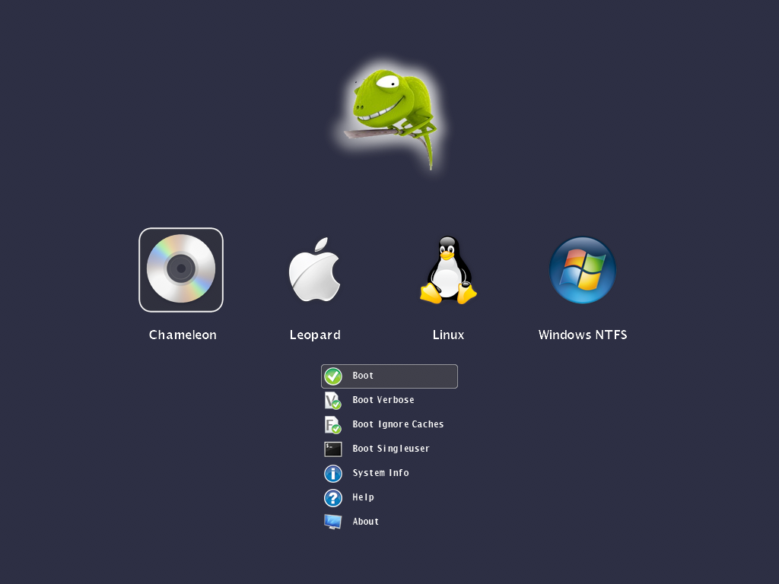
The Bootloaders
Notes:
18

Slide 19
What is a Bootloader?
Simply, a loader (program), which boot (starts) up the system.
A Customized program started by
Controller’s internal code in embedded System
Or, External Pre-programmed Code (like BIOS) in Desktop machines
Notes:
19
BIOS: Basic Input/Output System more detail: http://en.wikipedia.org/wiki/BIOS

Slide 20
Task of bootloader
Initialization Tasks
Memory Setup & Initialization
System Peripheral Initialization for the kernel
Actual Task
Load the RAM-based File System, like initrd, initramfs…
Load the kernel with proper arguments
Jump the the start of the kernel
Additional Task
Multi-kernel boots
Multi-way boots
Notes:
20

Slide 21
Design of bootloader
A Bootloader is started by a fixed code
It needs to be placed at the hard-coded location
Hard-code locations are not big enough for the complete code (/logic/task) of the bootloader
Hence, it is typically split into 2 portions
Stage1: small enough to load stage2 from our desired location
Stage2: The actual bootloader we want to have
Notes:
21

Slide 22
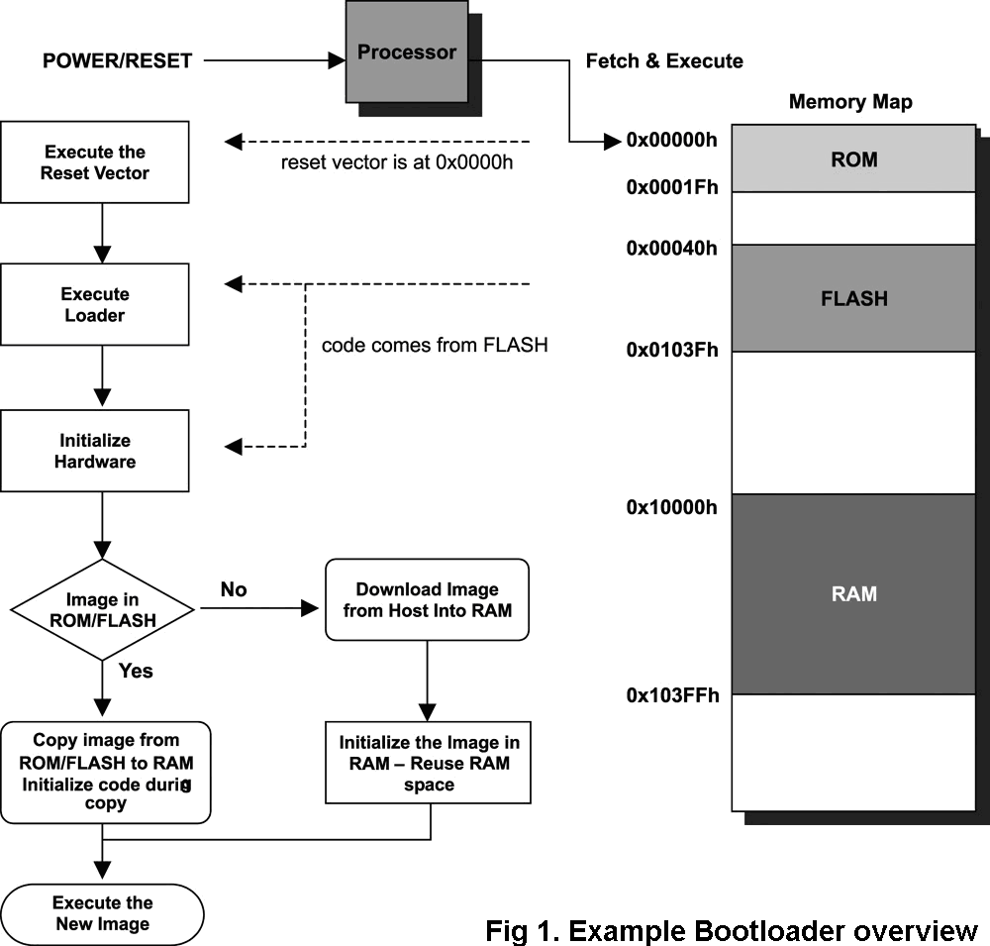
Design of bootloader

Slide 23
Bootloader comparisons
On Desktops
Initialization tasks are done by BIOS
Bootloader is just to boot kernel
On Embedded Systems
All need to be done by bootloader
But in optimized way
Hence two bootloader are
Quite difference from each other
Later being more board dependent & constrained
Notes:
23

Slide 24
Stage 2 Bootloader Flavours
Prevalent Desktop Bootloaders
LILO
GRUB
WIN7 Loader
Chameleon
Popular Embedded System Bootloaders
U-boot
Bootloader Object(BLOB)
Redboot
Notes:
24
http://en.wikipedia.org/wiki/LILO_(boot_loader)

Slide 25

Linux kernel
Notes:
25
http://en.wikipedia.org/wiki/LILO_(boot_loader)

Slide 26
Configuring the Kernel
First step to build kernel for your target
Output is .config file
Notes:
26
http://en.wikipedia.org/wiki/LILO_(boot_loader)

Slide 27
Configuration Options
Code maturity level options
Loadable module support
General setup
Memory technology devices
Block devices
Networking options
ATA/IDE/MFM/RLL support
SCSI support
Network device support
Input core support
Character devices
Filesystems
Console drivers
Sound
Kernel hacking
Notes:
27
http://en.wikipedia.org/wiki/LILO_(boot_loader)

Slide 28
Configuration Methods
- make config:
Command line interface
- make oldconfig:
Feeds config with a an existing .config configuration file, and prompts you to configure only those options you had not previously configured.
- make menuconfig:
Displays a curses-based terminal configuration menu.
- make xconfig:
Displays a Tk-based X Window configuration menu

Slide 29
Compiling the Kernel
Four steps to compile kernel:
Building kernel dependencies.
Building kernel image.
Building kernel module.

Slide 30
Building Dependencies
Most files in the kernel's sources depend on a number of header file
For each subdirectory in the kernel tree, a hidden .depend file is created during the h dependencies build. This contains the list of header files that each file in the directory depends on
$ make ARCH=arm CROSS_COMPILE=arm-linux- clean dep

Slide 31
Building the Kernel
Verifying the Cross-Development Toolchain
Compile the kernel
$ make ARCH=arm CROSS_COMPILE=arm-linux- zImage
Output is zImage is kernel image that is compressed using the gzip algorithm
vmlinux is kernel image that is uncompressed
On the x86, there is bzImage which means “big xImage”

Slide 32
Building the Modules
Command to build kernel modules
$ make ARCH=arm CROSS_COMPILE=arm-linux- modules
Duration of this stage depend on the number of kernel options you chose to build as modules

Slide 33
Installing the Kernel
copy kernel image file to the kernel partition
using command make modules_install to install modules to the rootfs

Slide 34
Q & A

